Slide 1
Adaptive Piecewise Multilinear Maps for Robust, Generalizable Data-driven Turbulence Models CSE 598-002 Final Project
Computational AeroSciences Laboratory
Department of Aerospace Engineering, University of Michigan
Ann Arbor, MI, USA
Niloy Gupta

Slide 2
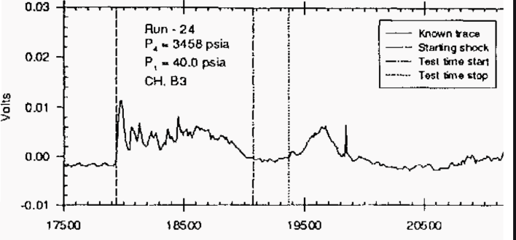
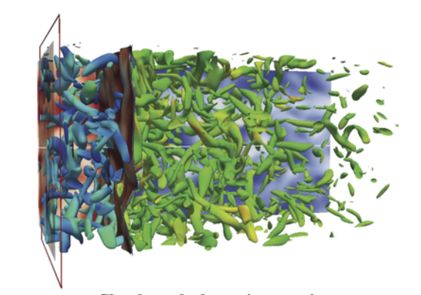
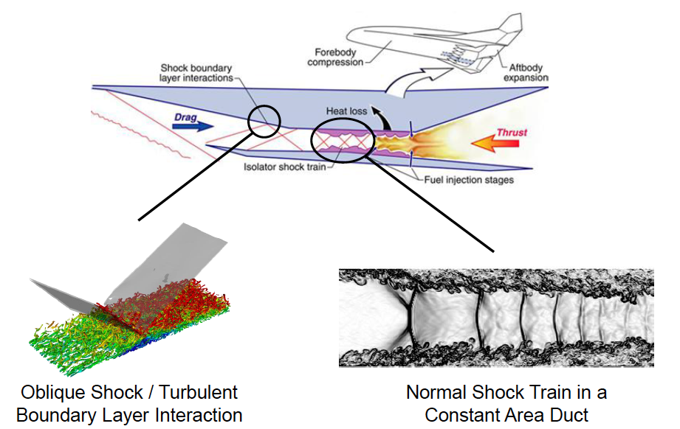
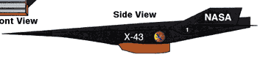
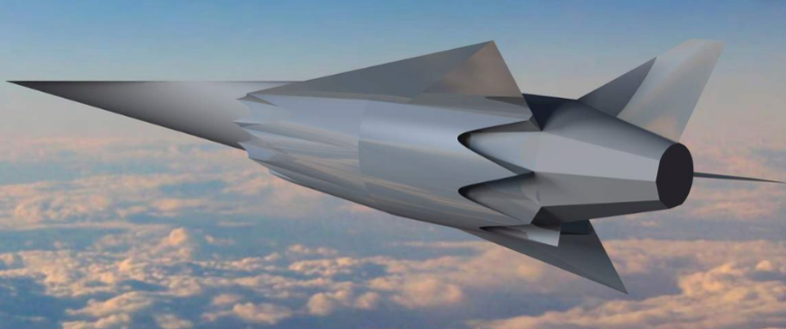
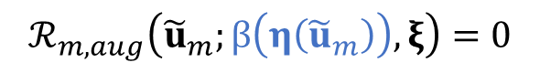
Generalizable Turbulence Models
Extract information from systems X₁, X₂,.. X_{n}, and make predictions in different systems Y, Z that share similar physics
$$ℛ_{m,aug}\left({\tilde{u}}_{m};β\left(η\left({\tilde{u}}_{m}\right)\right),ξ\right)=0$$
Generalizable ⇒ predictive capability on unseen configurations

Slide 3
Ensuring Robustness
Typically, ML models use neural networks
Excellent approximators
Drawbacks
Poor extrapolators
Many design and training options
Expensive to train
Answer: localized learning
ML model should only deviate from baseline in regions with data
At worst, ML model predicts baseline behavior
Ensures physically realizable predictions
How can we ensure robustness during extrapolation?

Slide 4
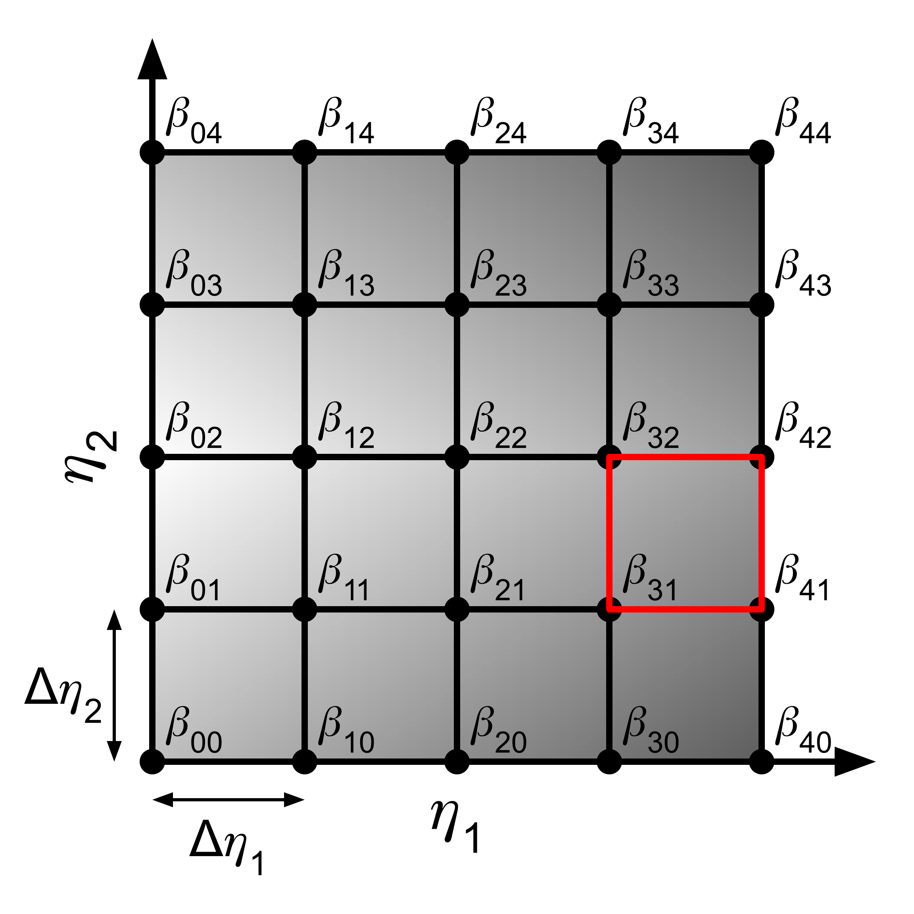
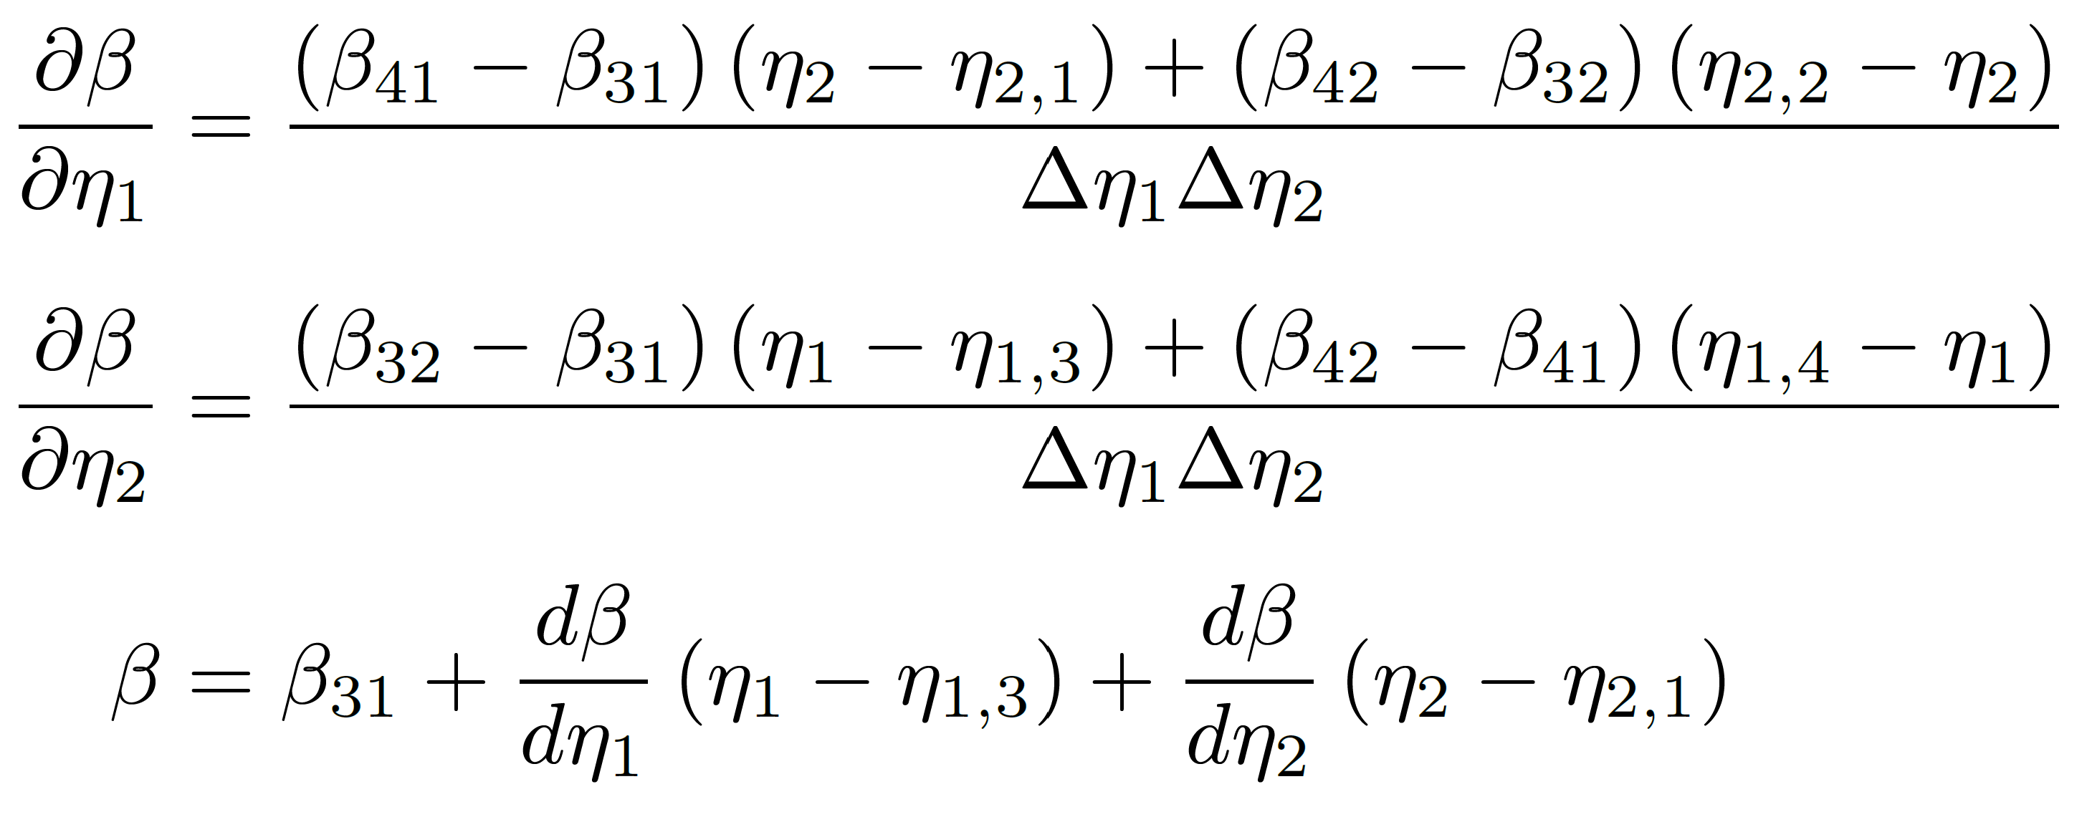
Piecewise Multilinear Maps (PMMs)
Discretize feature-space
Model parameters are desired output values
Parameters only change if data is nearby
Intrinsically implements localized learning
Uniform discretization
PMM structure is implicitly stored
Constant-time complexity output calculation
Simple implementation
Shown to outperform neural networks
Easier to train
Consistent, robust extrapolative behavior
Improved generalizability

Slide 5
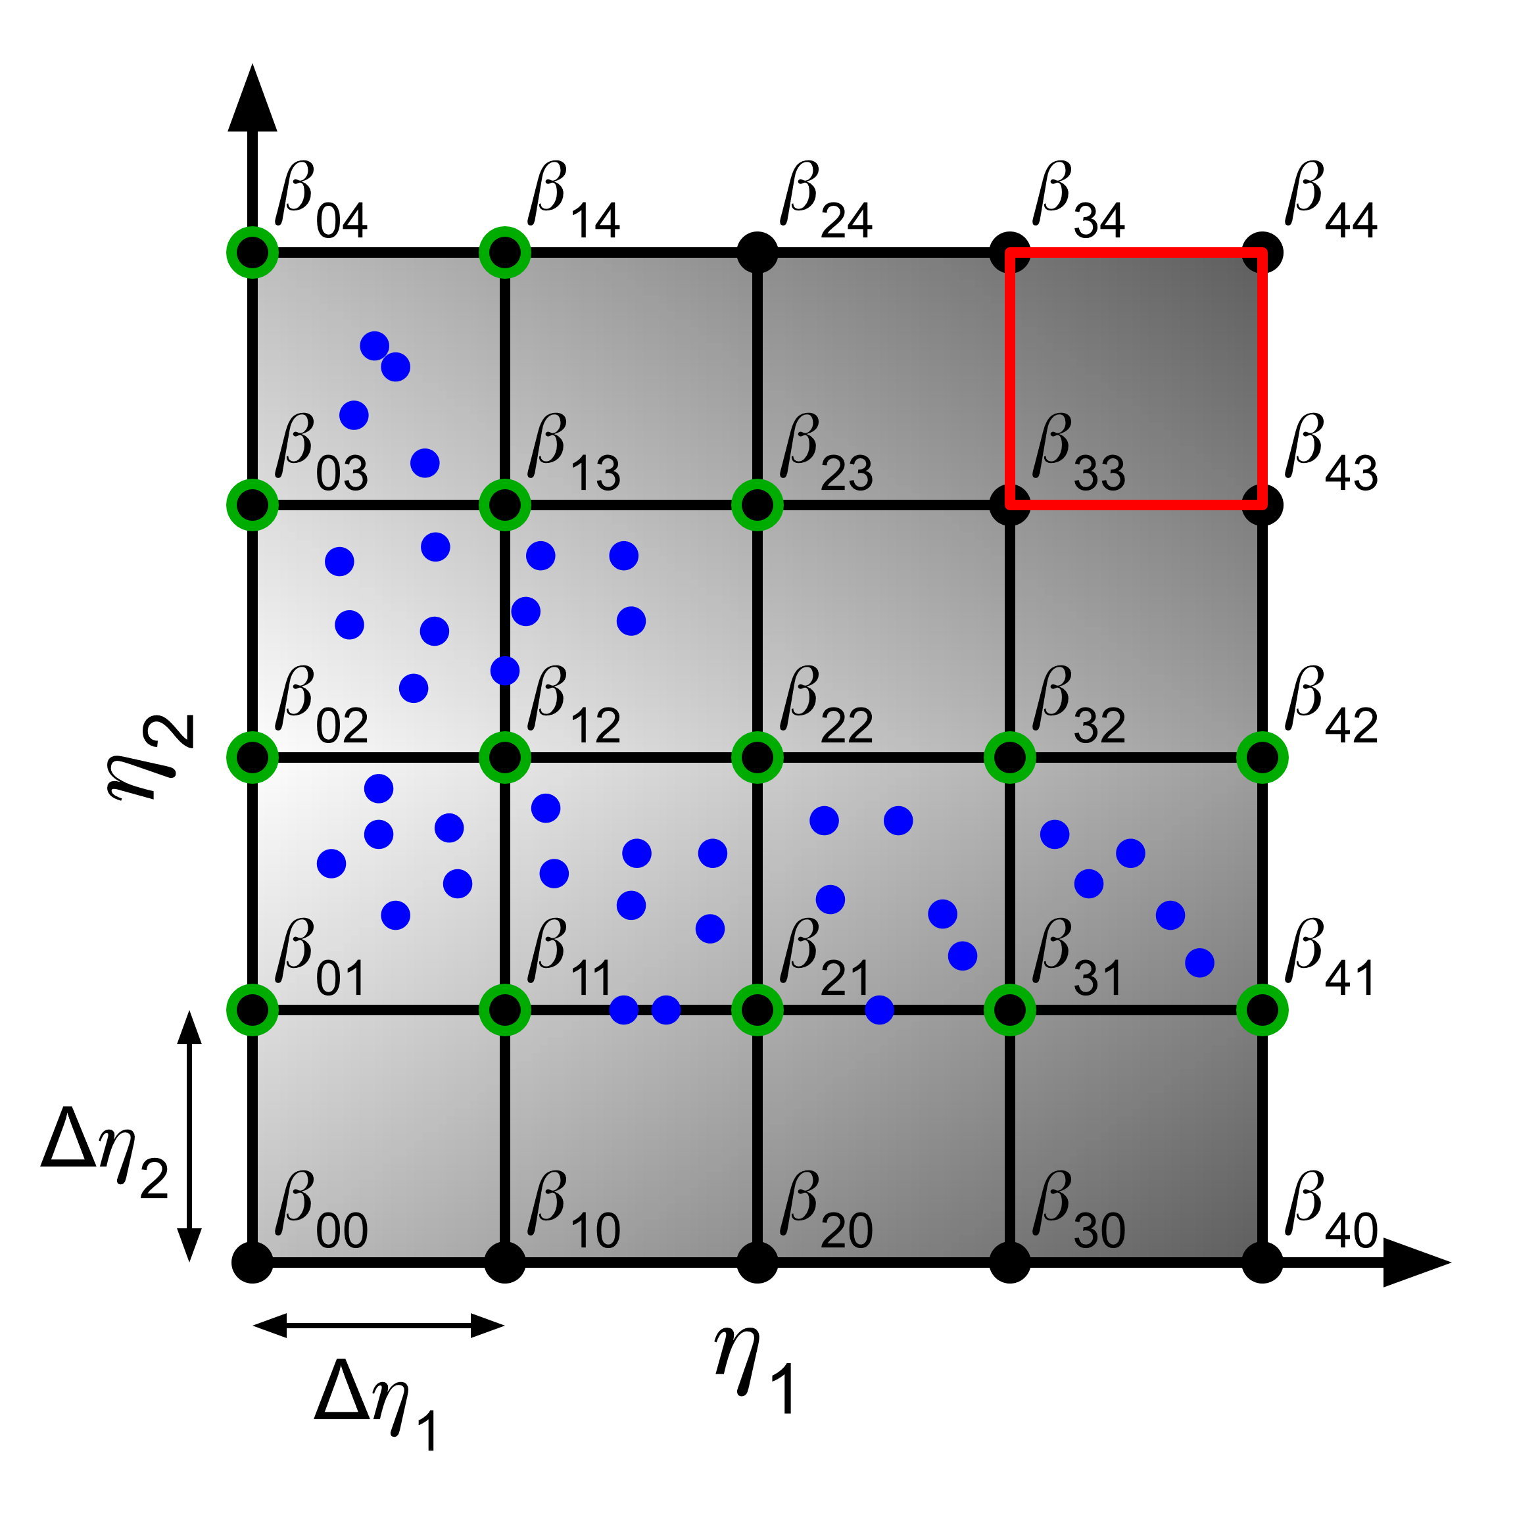
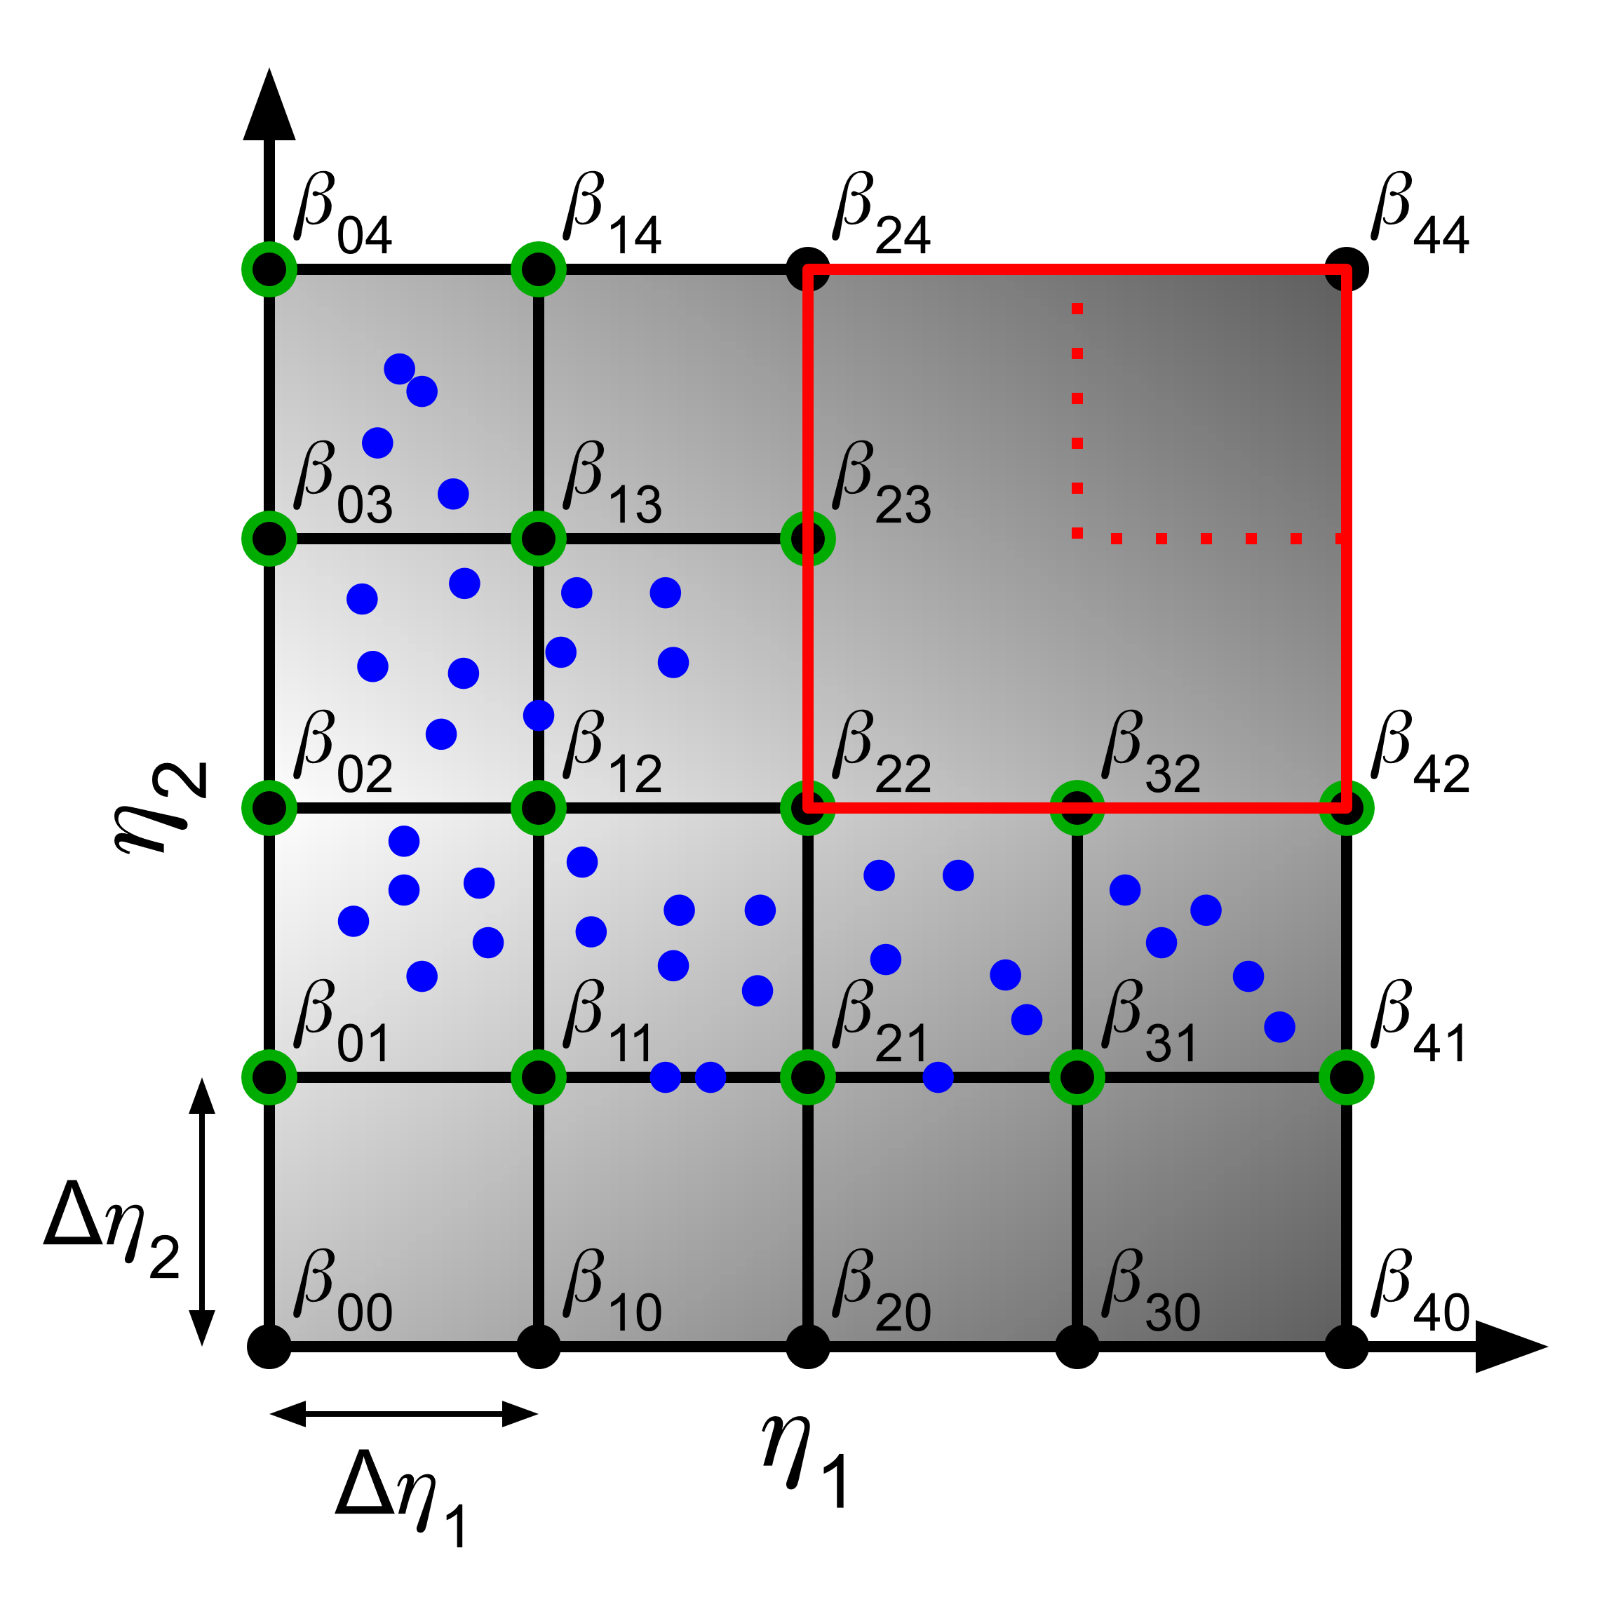
Issues with Uniform Discretization
Calculations in red cell always return baseline model
In same region, calculations influenced by training data

Slide 6
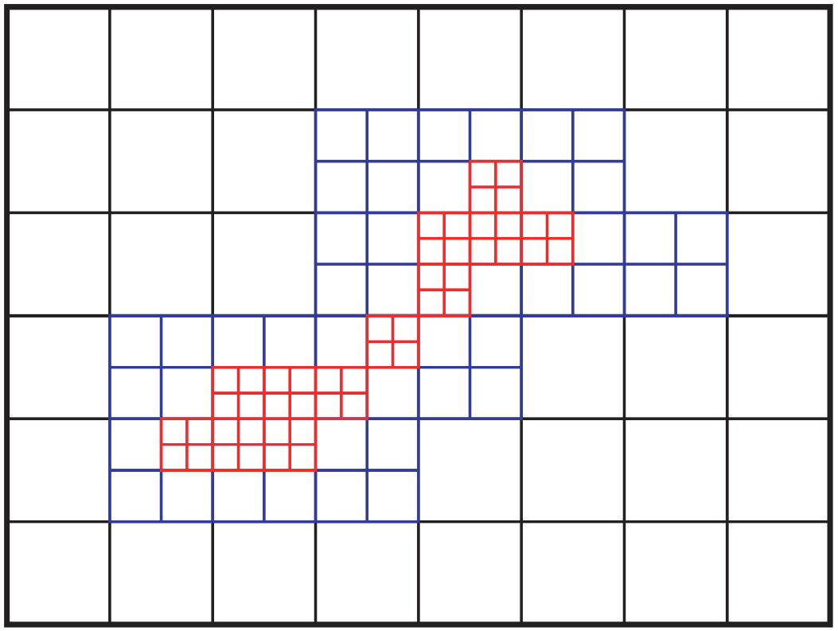
Adaptive PMM Implementation
Take inspiration from pointwise adaptive mesh refinement
Hyperoctree refinement of cells
Keeps a structured representation
In regions with more data, have smaller cells
Ensure neighboring cells do not vary by more than a factor of two
Developed a simple n-dimensional mesh format
Store which cells in each level are refined
Store which nodes define or lie on every cell
PMM output calculation algorithm
Input: feature coordinates
Determine which leaf cell coordinates lie in
If cell has no hanging node, use n-linear interpolation
If cell has hanging nodes, use inverse distance weighting
Output – Interpolated function value at feature-coordinates

Slide 7
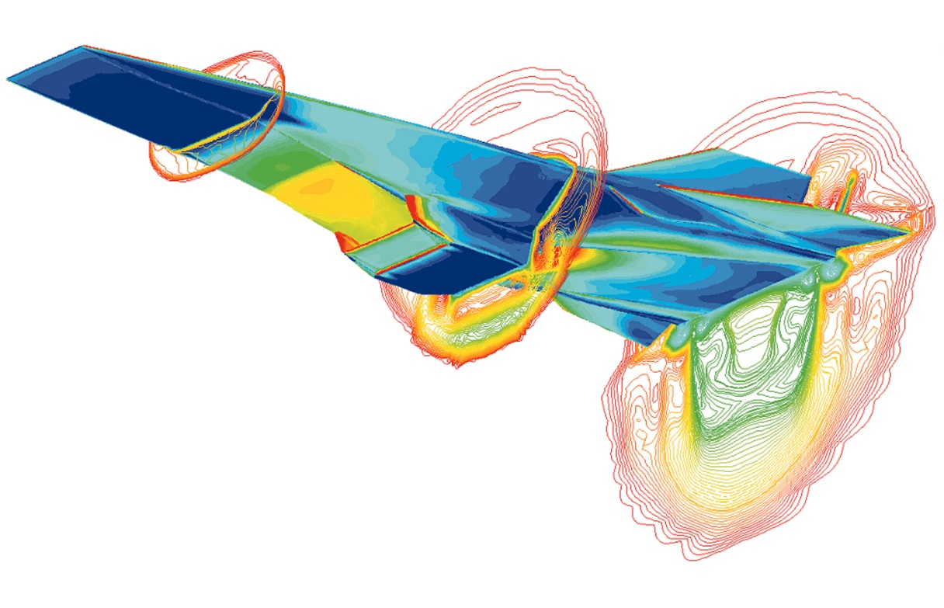
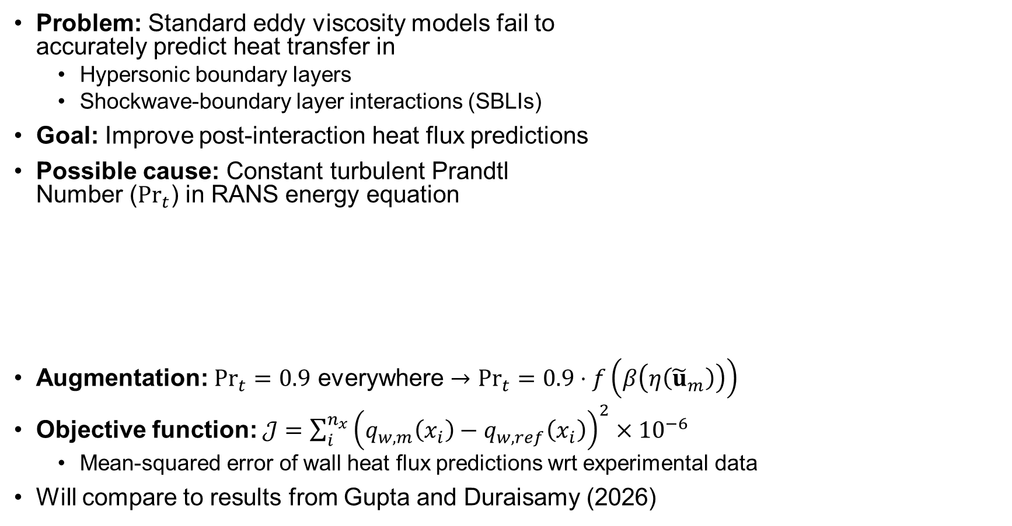
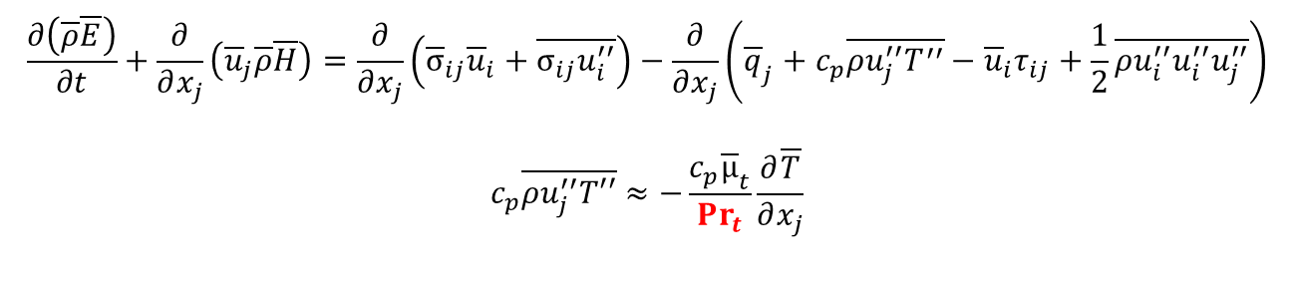
Application to Hypersonic Heat Flux
Problem: Standard eddy viscosity models fail to accurately predict heat transfer in
Hypersonic boundary layers
Shockwave-boundary layer interactions (SBLIs)
Goal: Improve post-interaction heat flux predictions
Possible cause: Constant turbulent Prandtl Number ($Pr_{t}$) in RANS energy equation
Augmentation: $Pr_{t}=0.9$ everywhere $→Pr_{t}=0.9⋅f\left(β\left(η\left({\tilde{u}}_{m}\right)\right)\right)$
Objective function: $𝒥=\sum_{i}^{n_{x}}{{\left(q_{w,m}\left(x_{i}\right)−q_{w,ref}\left(x_{i}\right)\right)}^{2}}×{10}^{−6}$
Mean-squared error of wall heat flux predictions wrt experimental data
Will compare to results from Gupta and Duraisamy (2026)
NASA, (2009)
$$\frac{∂\left(\overline{ρ}\overline{E}\right)}{∂t}+\frac{∂}{∂x_{j}}\left({\overline{u}}_{j}\overline{ρ}\overline{H}\right)=\frac{∂}{∂x_{j}}\left({\overline{σ}}_{ij}{\overline{u}}_{i}+\overline{σ_{ij}u_{i}^{′′}}\right)−\frac{∂}{∂x_{j}}\left({\overline{q}}_{j}+c_{p}\overline{ρu_{j}^{′′}T^{′′}}−{\overline{u}}_{i}τ_{ij}+\frac{1}{2}\overline{ρu_{i}^{′′}u_{i}^{′′}u_{j}^{′′}}\right)$$
$$c_{p}\overline{ρu_{j}^{′′}T′′}≈−\frac{c_{p}{\overline{μ}}_{t}}{Pr_{t}}\frac{∂\overline{T}}{∂x_{j}}$$

Slide 8
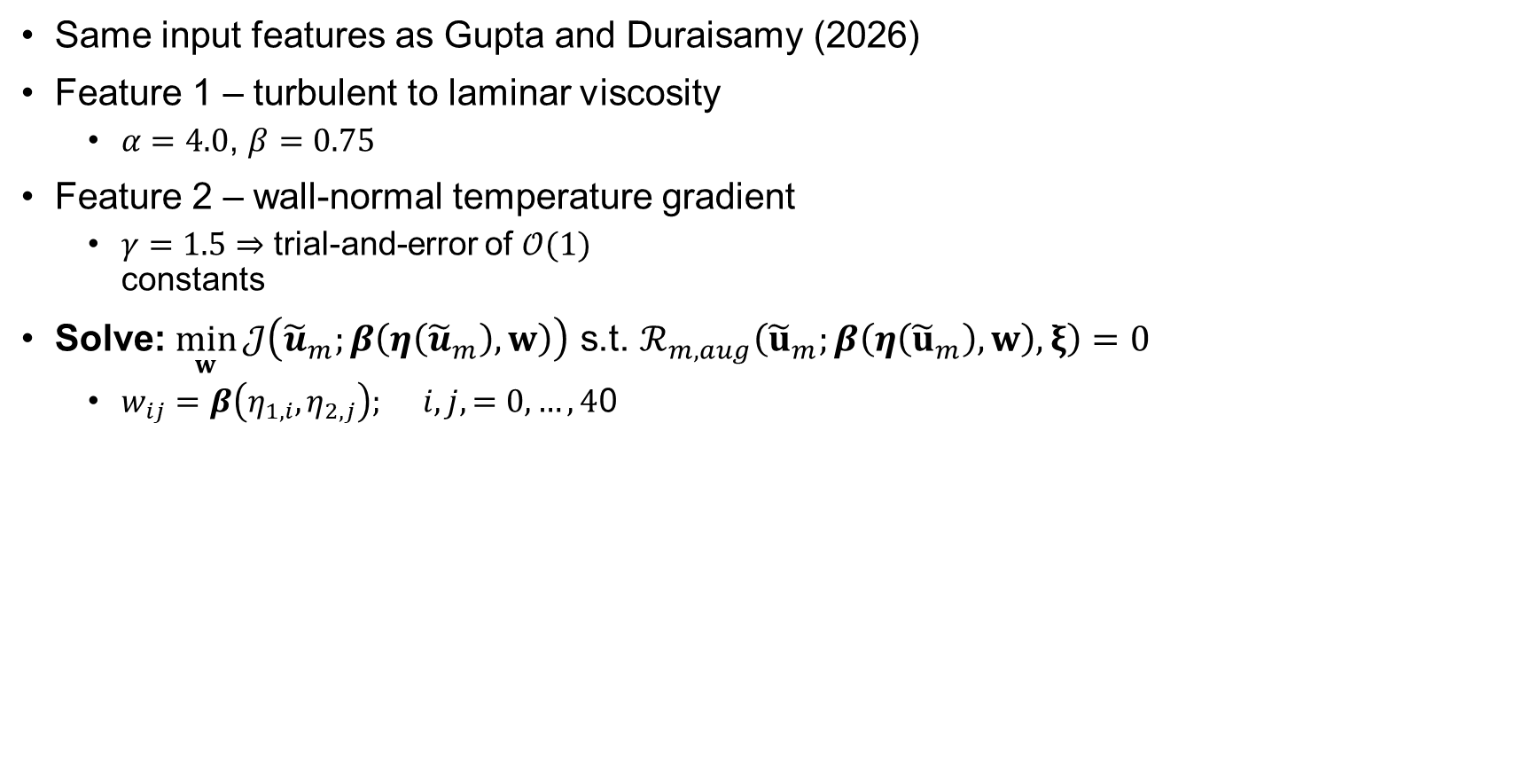
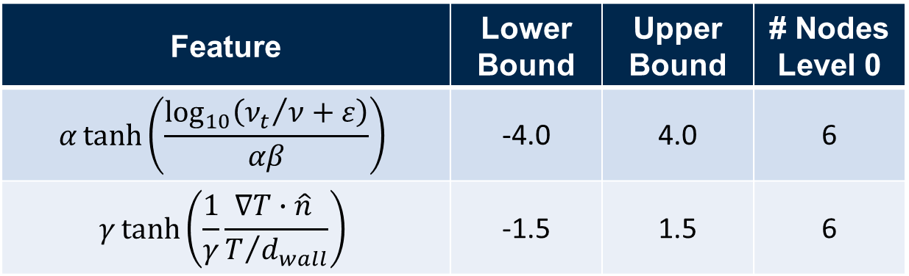
Model Design
Same input features as Gupta and Duraisamy (2026)
Feature 1 – turbulent to laminar viscosity
$α=4.0$, $β=0.75$
Feature 2 – wall-normal temperature gradient
$γ=1.5$ ⇒ trial-and-error of $𝒪(1)$ constants
Solve: $\min_{w}{𝒥\left({\tilde{u}}_{m};β\left(η\left({\tilde{u}}_{m}\right),w\right)\right)}$ s.t. $ℛ_{m,aug}\left({\tilde{u}}_{m};β\left(η\left({\tilde{u}}_{m}\right),w\right),ξ\right)=0$
$w_{ij}=β\left(η_{1,i},η_{2,j}\right); i,j,=0,…,4$0
Feature | Lower Bound | Upper Bound | # Nodes Level 0
$$α\tanh\left(\frac{\log_{10}\left({ν_{t}}/ν+ε\right)}{αβ}\right)$$ | -4.0 | 4.0 | 6
$$γ\tanh\left(\frac{1}{γ}\frac{∇T∙\hat{n} }{T/{d_{wall}}}\right)$$ | -1.5 | 1.5 | 6

Slide 9
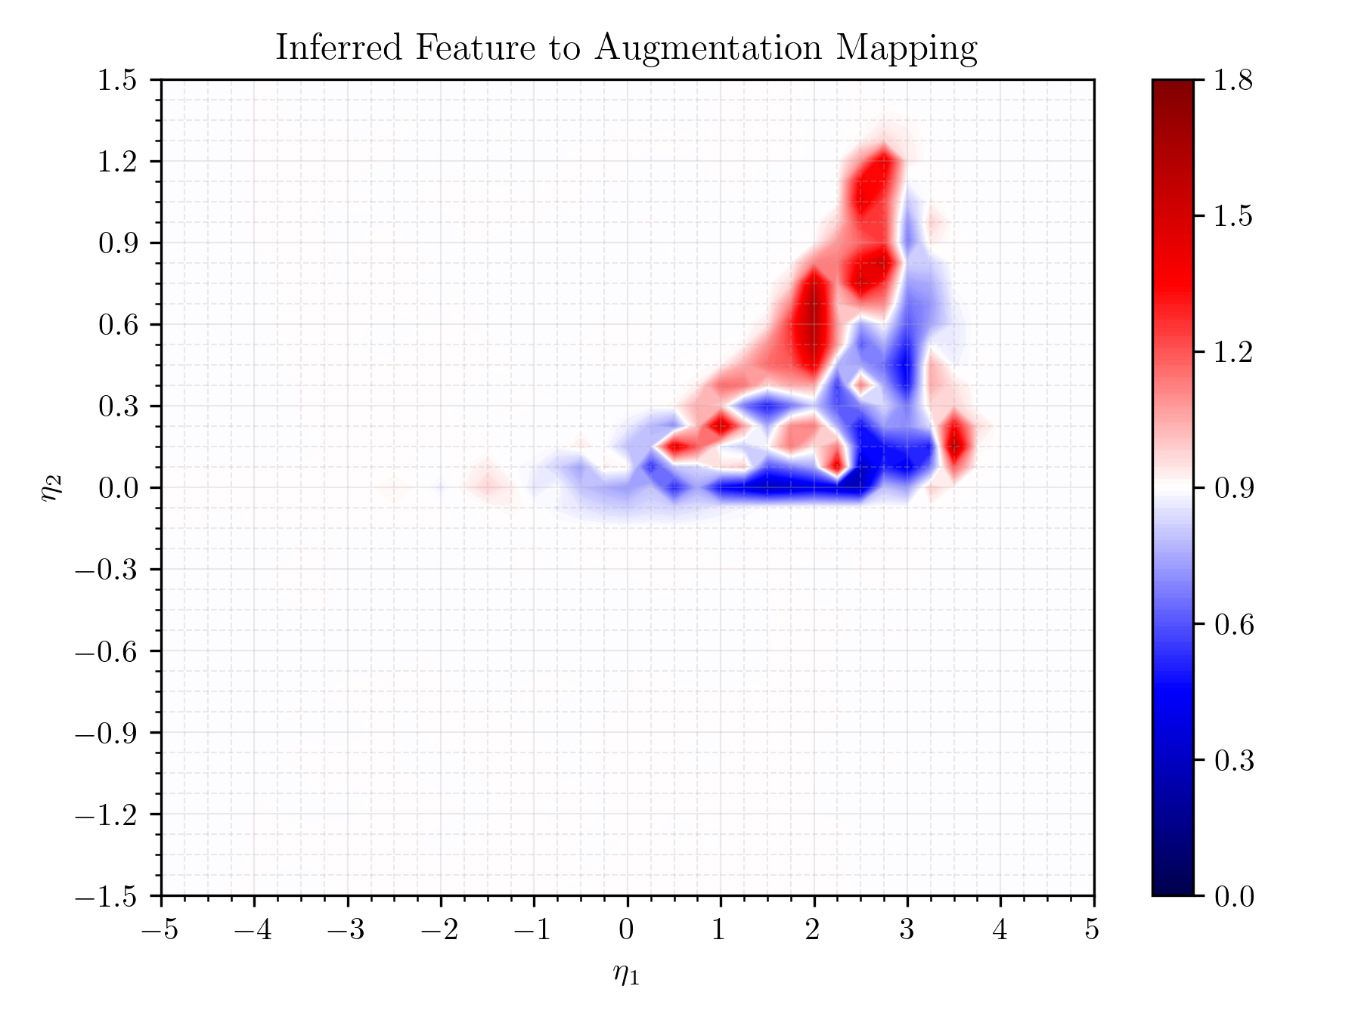
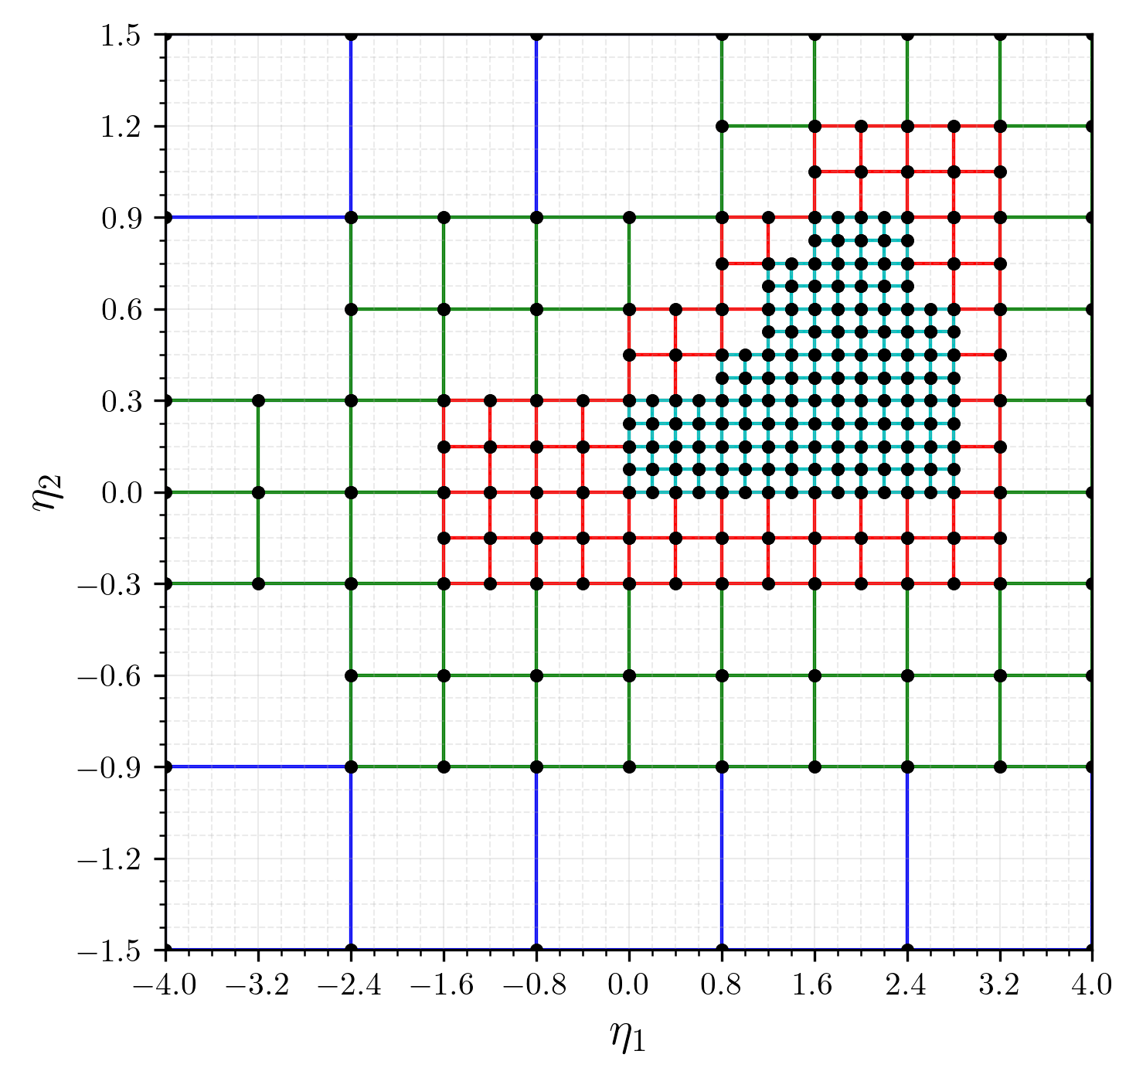
New Feature Space Discretization
1681 parameters 261 parameters

Slide 10
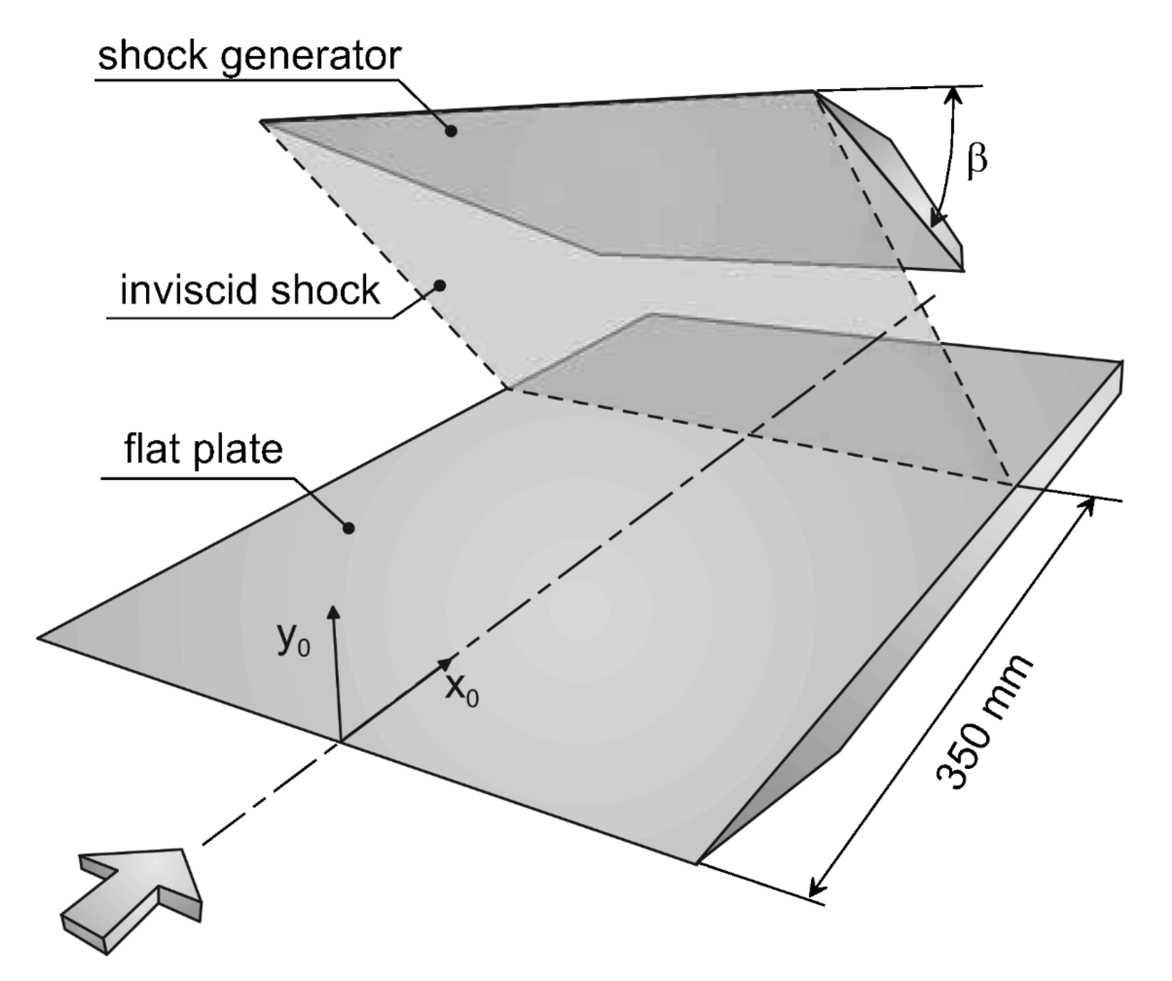
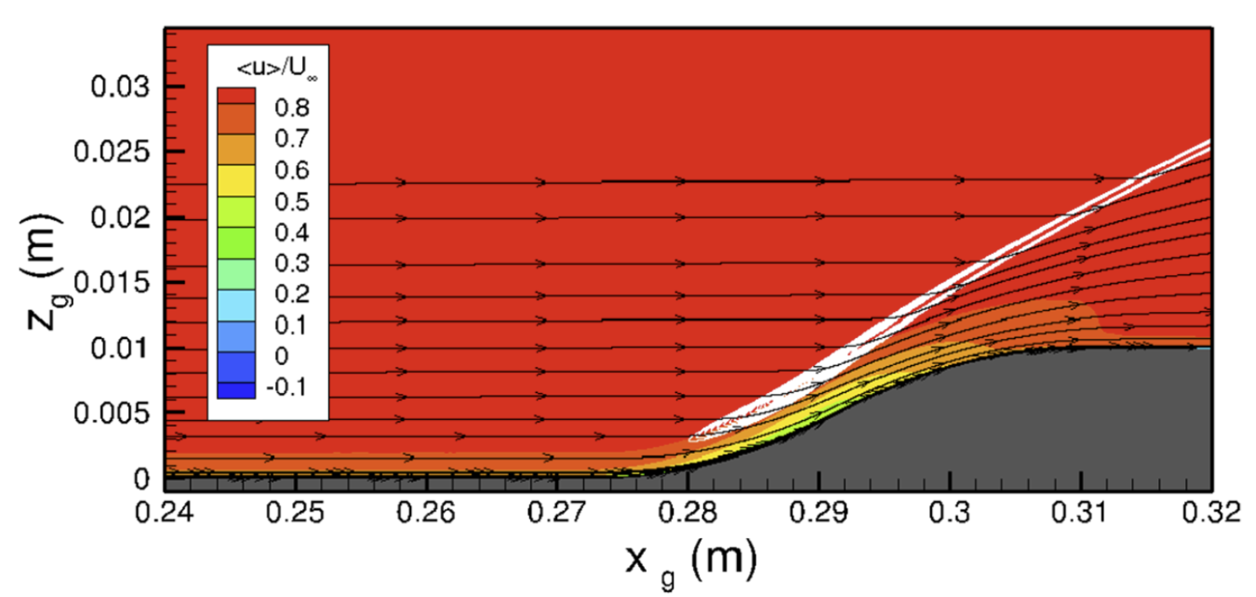
Cases and Data
Training: Schulein (2006)
Validation: Nicholson et al. (2024)
Mach 5
Flat plate
Oblique impinging shocks
S14 ⇒ 14° shock deflection angle
Strongest shock, flow separation
Mach 5
Curved wall
Intrinsically generated shock

Slide 11
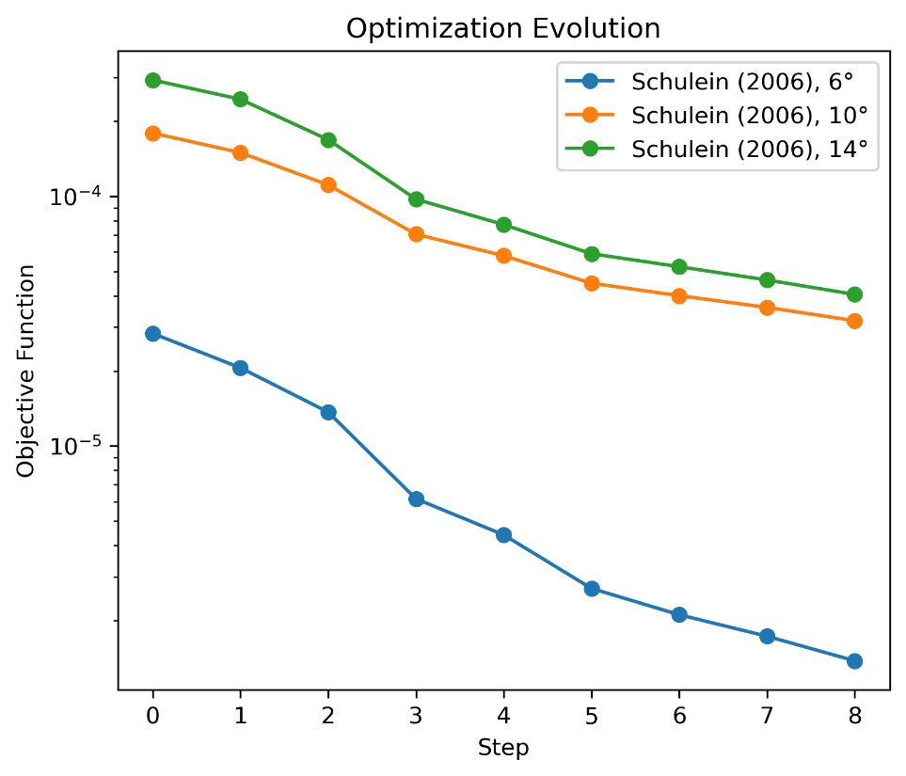
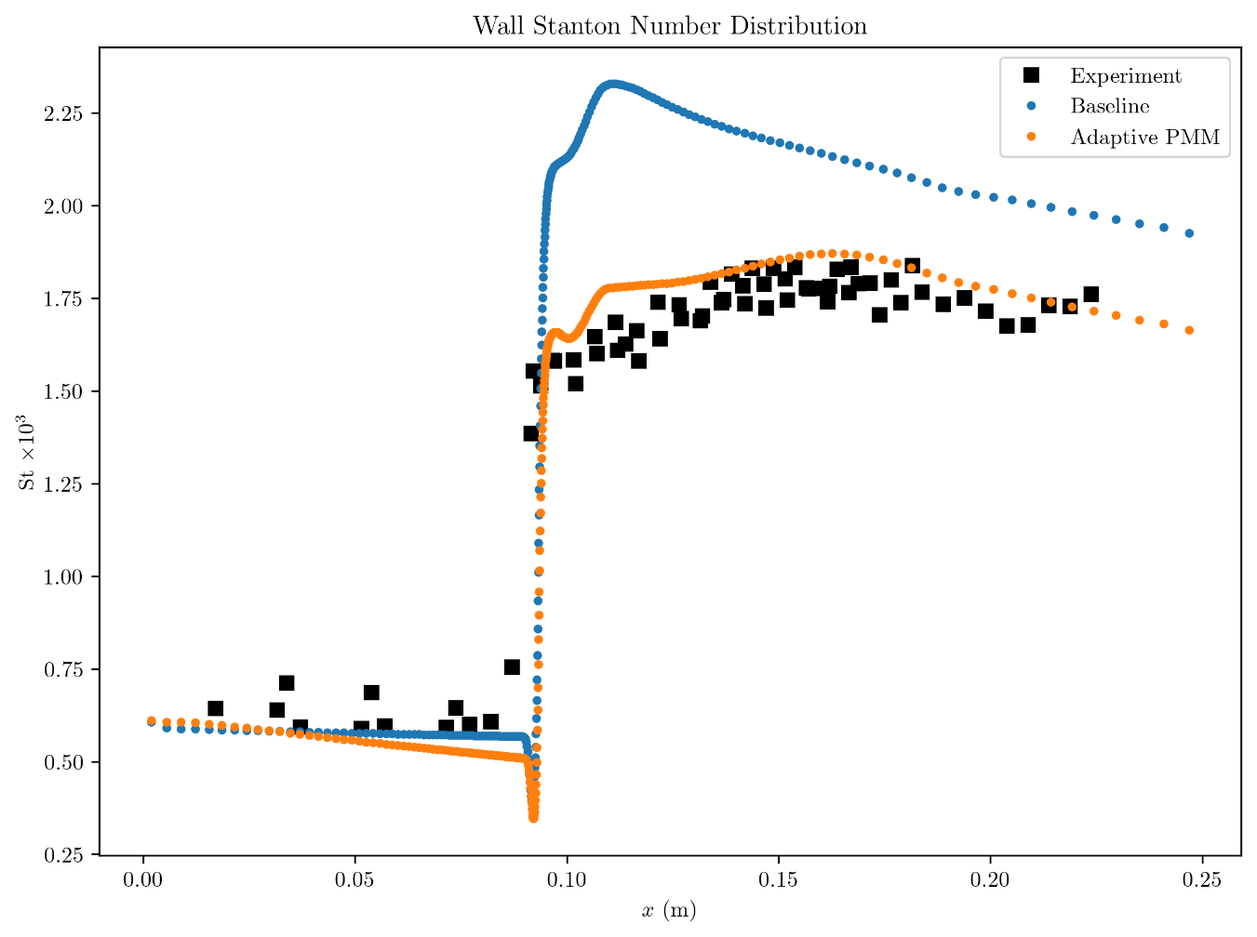
Results
Adaptive PMM implementation works
Yields improved heat transfer predictions during training

Slide 12
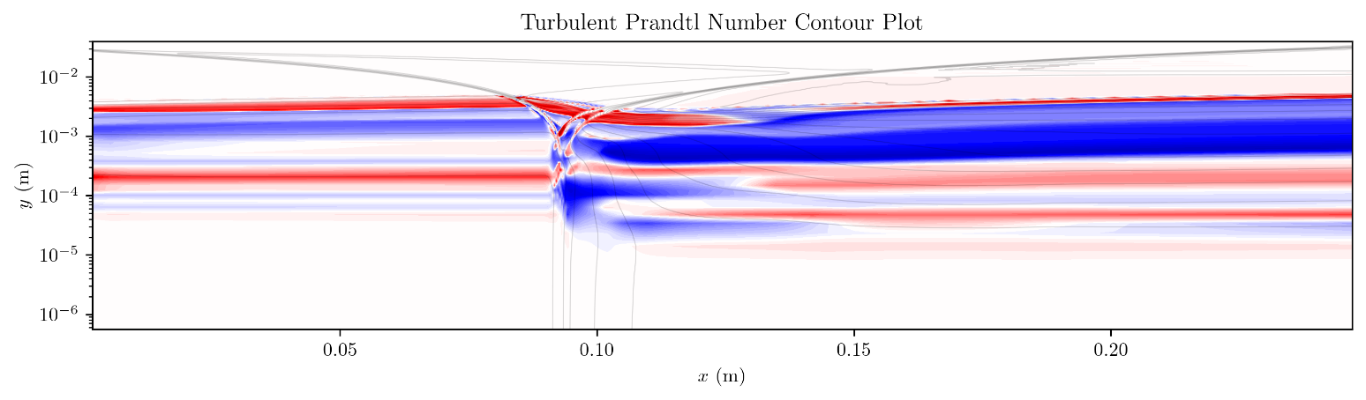
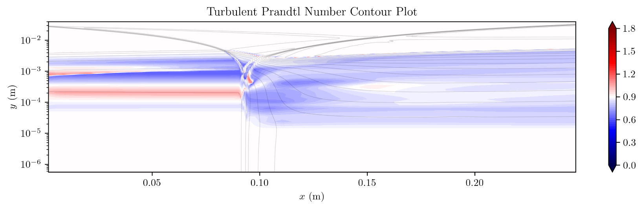
Results
My handcrafted adaptive mesh seems to be causing problems
RANS simulations struggle to converge
Inferred augmentation fields for adaptive PMM miss some features the uniform PMM learned
Uniform
Adaptive

Slide 13
Conclusions
Integrated an adaptive PMM within a RANS solver
Significantly reduce number of parameters in the model
Yielded improved predictions during training
Adaptive mesh is inadequate
Future work
Improve the adaptive mesh used
Develop framework for automatic adaptive PMM mesh generation
Extend adaptive PMM implementation to n-dimensions
Improve quadtree mesh memory usage and search algorithm

Slide 14
Appendix

Slide 15
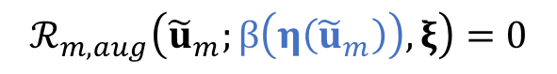
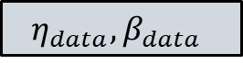
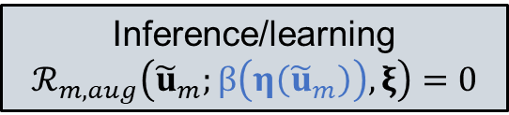
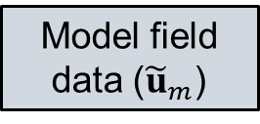
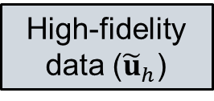
Model Consistent Learning
Model field data (${\tilde{u}}_{m}$)
Infer model environment and learn in the context of the model
High-fidelity data (${\tilde{u}}_{h}$)
Inference/learning
$$ℛ_{m,aug}\left({\tilde{u}}_{m};β\left(η\left({\tilde{u}}_{m}\right)\right),ξ\right)=0$$
$$η_{data}, β_{data}$$
Trained model
Model augmentation
Prediction
$$ℛ_{m,aug}\left({\tilde{u}}_{m};β\left(η\left({\tilde{u}}_{m}\right)\right),ξ\right)=0$$
Srivastava and Duraisamy, 2021
Learn $β\left(η\left(u_{h}\right)\right)$ directly ⇒ Consistent modeling ⇒ Improved accuracy
Notes:
If we have a discrepancy model beta expressed in terms of features eta of model states u, we can embed this model into our fluid solver and perform an iterative optimization procedure. With this approach, we learn how to predict high fidelity data in terms of low fidelity states, ensure model consistent and improving accuracy.

Slide 16
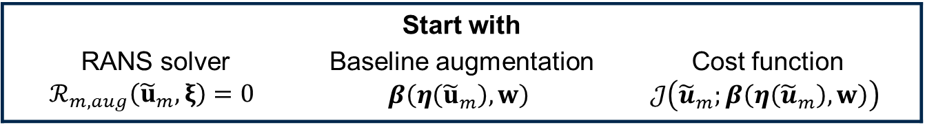

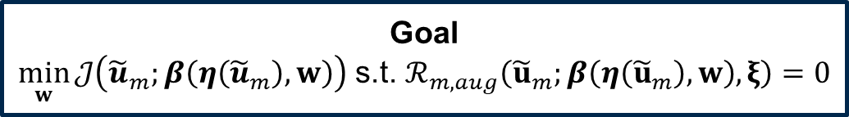
Model-embedded Inference
Start with
RANS solver | Baseline augmentation | Cost function
$$ℛ_{m,aug}\left({\tilde{u}}_{m},ξ\right)=0$$ | $$β\left(η\left({\tilde{u}}_{m}\right),w\right)$$ | $$𝒥\left({\tilde{u}}_{m};β\left(η\left({\tilde{u}}_{m}\right),w\right)\right)$$
Goal
$\min_{w}{𝒥\left({\tilde{u}}_{m};β\left(η\left({\tilde{u}}_{m}\right),w\right)\right)}$ s.t. $ℛ_{m,aug}\left({\tilde{u}}_{m};β\left(η\left({\tilde{u}}_{m}\right),w\right),ξ\right)=0$
$$\frac{d𝒥^{k}}{du^{k}}$$
$$\frac{dℛ_{m,aug}^{k}}{du^{k}}$$
Chain rule ⇒ $\frac{d𝒥^{k}}{dw}=\frac{d𝒥^{k}}{dβ^{k}}\frac{∂β^{k}}{∂w}=\left(\frac{∂𝒥^{k}}{∂β^{k}}−\left[\frac{∂𝒥^{k}}{∂{\tilde{u}}_{m}^{k}}+\frac{∂𝒥^{k}}{∂β^{k}}\frac{∂β^{k}}{∂{\tilde{u}}_{m}^{k}}\right]{\left[\frac{∂ℛ_{m,aug}^{k}}{∂{\tilde{u}}_{m}^{k}}+\frac{∂ℛ_{m,aug}^{k}}{∂β^{k}}\frac{∂β^{k}}{∂{\tilde{u}}_{m}^{k}}\right]}^{−1}\frac{∂ℛ_{m,aug}^{k}}{∂β^{k}}\right)\frac{∂β^{k}}{∂w}$
Backpropagation or computational tapes ⇒ $\frac{∂β^{k}}{∂w}$
Adjoint computation ⇒ $\frac{d𝒥^{k}}{dβ^{k}}$
Solve $ψ^{T}\frac{∂ℛ_{m,aug}^{k}}{∂{\tilde{u}}_{m}^{k}}=−\frac{∂𝒥^{k}}{∂{\tilde{u}}_{m}^{k}}$ ⇒ $ψ^{T}=−\frac{∂𝒥^{k}}{∂{\tilde{u}}_{m}^{k}}{\left[\frac{∂ℛ_{m,aug}^{k}}{∂{\tilde{u}}_{m}^{k}}\right]}^{−1}$
Sensitivities $\frac{d𝒥^{k}}{dw}=\left(\frac{∂𝒥^{k}}{∂β^{k}}+ψ^{T}\frac{∂ℛ_{m,aug}^{k}}{∂β^{k}}\right)\frac{∂β^{k}}{∂w}$ ⇒ iteratively update $w$

Slide 17
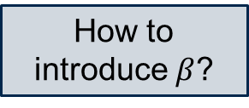
Learning Framework
Learning and inference assisted by feature-space engineering
(LIFE)
Parsimonious set of features
Generalizability to unseen configurations
One-to-one feature-to-augmentation map
Physics-based non-dimensionalization
Physics-informed feature selection
Appropriate bounded functional form
Inference from limited data
Minimized spurious predictions
How to introduce $β$?
Localized learning
Srivastava and Duraisamy, 2021

Slide 18
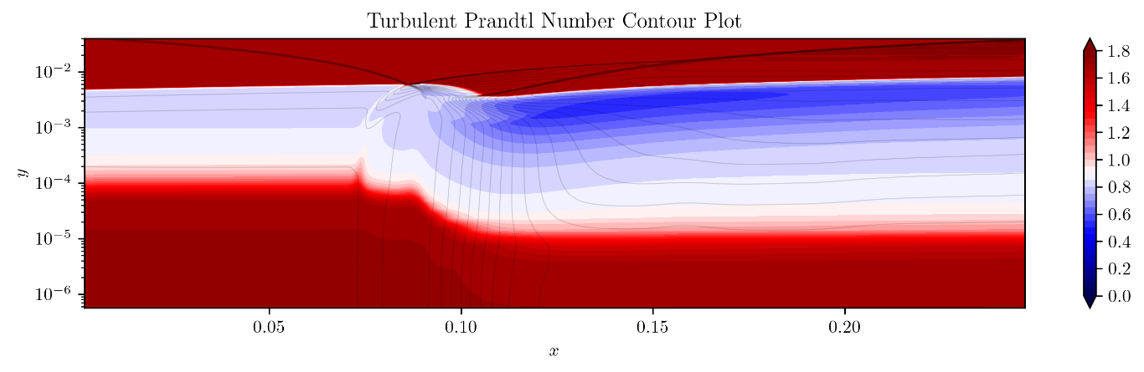
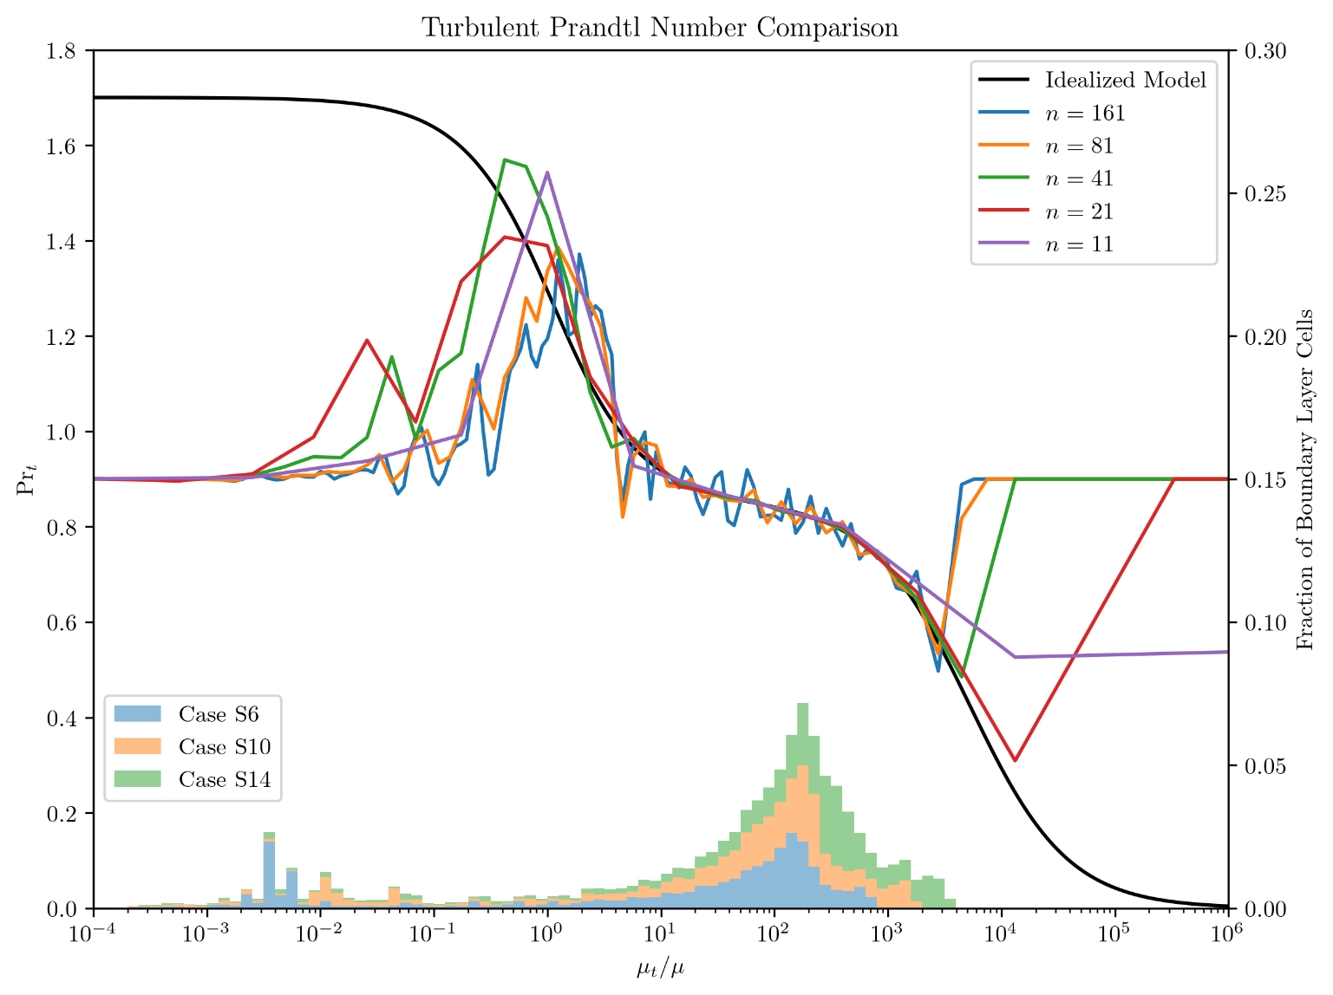
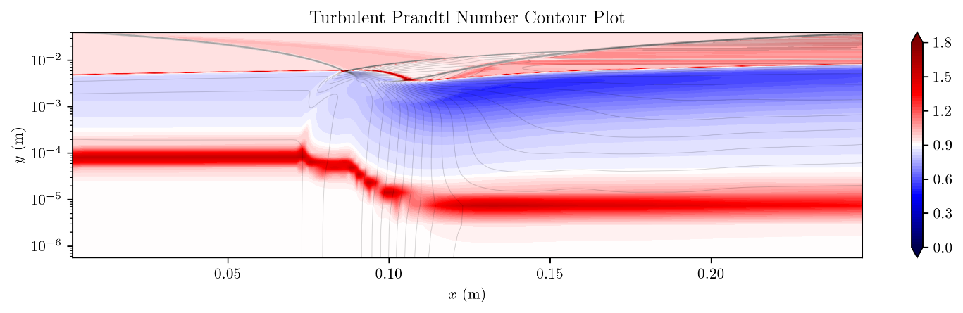
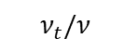
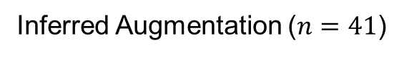
Generalizability of PMMs
Returns to baseline away from training data
Idealized Model
Inferred Augmentation ($n=41$)
Generalizability depends on number of parameters
$$ν_{t}/ν$$

Slide 19
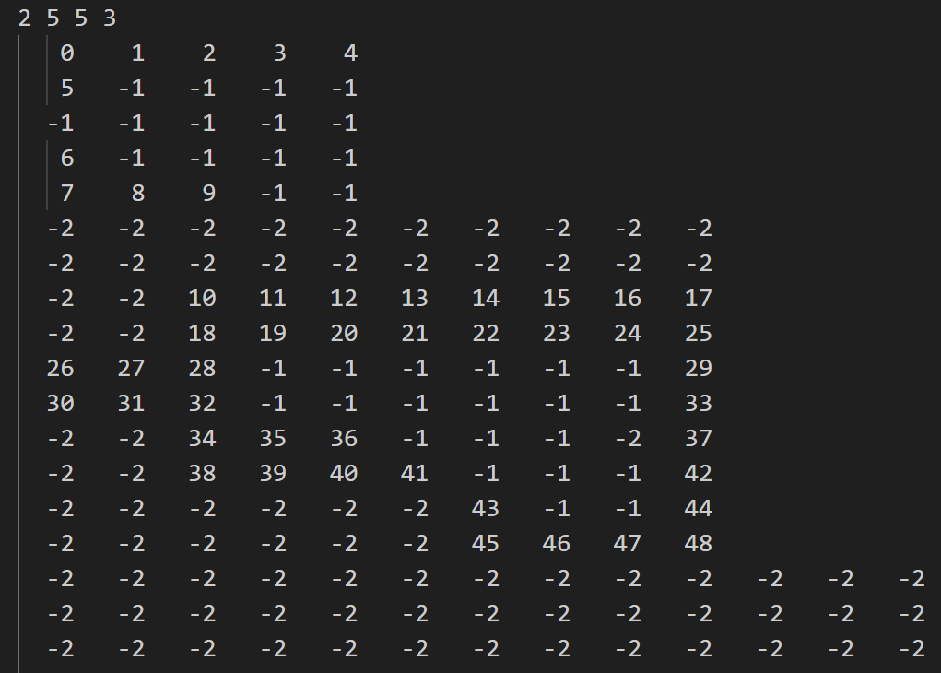
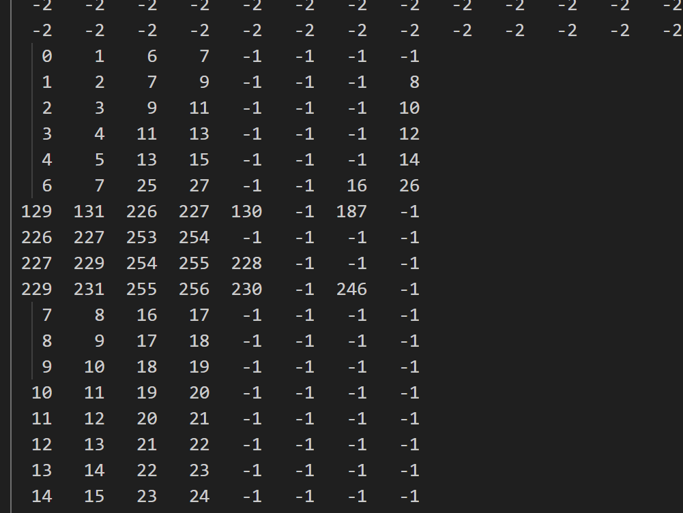
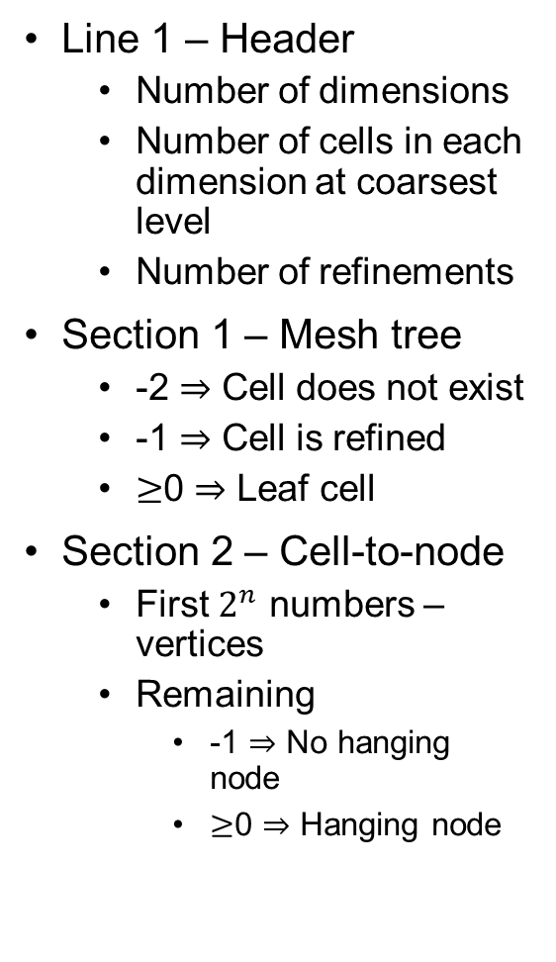
Mesh File Format
Line 1 – Header
Number of dimensions
Number of cells in each dimension at coarsest level
Number of refinements
Section 1 – Mesh tree
-2 ⇒ Cell does not exist
-1 ⇒ Cell is refined
$≥$0 ⇒ Leaf cell
Section 2 – Cell-to-node
First $2^{n}$ numbers – vertices
Remaining
-1 ⇒ No hanging node
$≥$0 ⇒ Hanging node

Slide 20
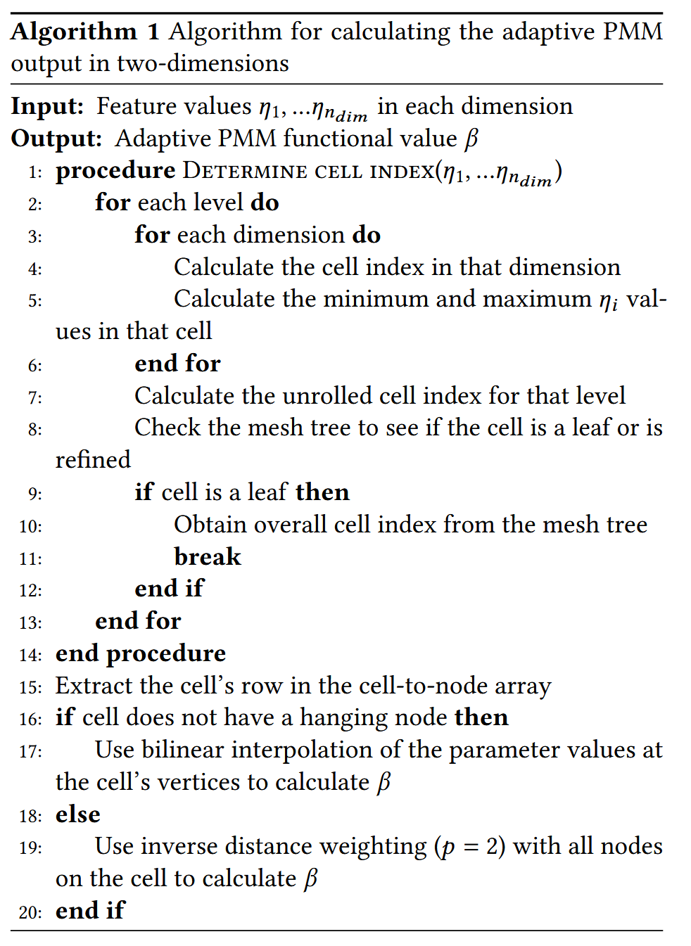
Full PMM Output Algorithm

